Slide 1

The Technology Value Stream
Gabe Conner
CSD380
1/18/26

Slide 2
What Is the Technology Value Stream?
The technology value stream describes the full flow of work required to turn an idea into working software delivered to users. This includes everything from planning and development to testing, deployment, and operations.
The value stream is used to show where work slows down, where delays happen, and how small inefficiencies stack up over time. The main goal is to make work move smoothly from start to finish instead of getting stuck between teams or processes.

Slide 3

Lead Time vs. Processing Time
According to the textbook, lead time is the total time it takes for a change to go from request to production. This includes waiting, approvals, handoffs, and delays.
Processing time is only the time when actual work is being done, like writing code, testing, or deploying.
The book points out that in most organizations, processing time is very small compared to lead time. A change may only take hours to build, but weeks or months to deliver.
An easy way to think about this would be:
Processing time = doing the work
Lead time = waiting for the work to move

Slide 4

The Common Scenario
Many organizations experience deployment lead times that stretch into weeks or even months. This often happens because changes move through multiple teams with manual approvals, large release batches, and limited automation.
When releases take a long time, teams tend to bundle more changes together, which increases risk. If something fails, it becomes much harder to identify the cause because so many things changed at once. This pattern is extremely common in traditional IT environments.

Slide 5
Why Long Lead Times Are a Problem
Bigger releases mean more risk
Problems are harder to trace
Feedback from users is delayed
Fixes take longer and cost more

Slide 6
The DevOps Ideal
The DevOps ideal is deployment lead times measured in minutes instead of months. This in no way means an increase in careless deployments. It means making deployments small, repeatable, and safe.
Most organizations that are actually able to achieve this rely heavily on automation, consistent environments, and strong testing practices. Since changes are small, failures are easier to fix and the recovery is faster.
Fast deployments support learning, stability, and confidence across teams.

Slide 7
What Makes Faster Value Streams
Limit
Limit work in progress
Reduce
Reduce handoffs between teams
Automate
Automate testing and deployments
Keep
Keep environments consistent

Slide 8
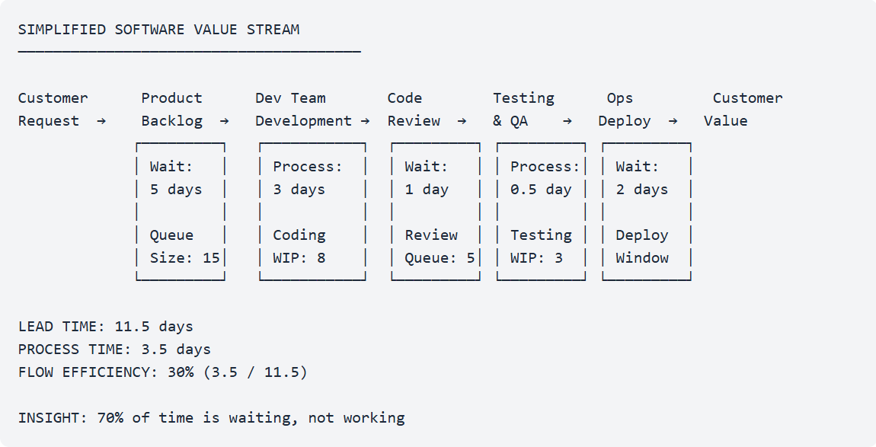
This graphic perfectly shows how most time spent in a value stream is spent waiting, not working.
Graphic from https://codepulsehq.com/guides/value-stream-mapping-engineering

Slide 9

Why the Technology Value Stream Matters
Understanding the technology value stream helps organizations identify where time is lost and where improvements will have the biggest impact.
By reducing lead time, teams deliver value faster, reduce deployment risk, and gain quicker feedback from users. This leads to better quality software and more stable systems over time.
Improving the value stream is one of the most practical ways to support DevOps goals.

Slide 10
Sources
Kim, G., Humble, J., Debois, P., & Willis, J. (2021). The DevOps handbook (2nd ed.). IT Revolution Press.
Forsgren, N., Humble, J., & Kim, G. (2018). Accelerate. IT Revolution Press.
Atlassian. (n.d.). What is DevOps? https://www.atlassian.com/devops

